Slide 1

















Sponsor screen
Notes:
Section 1 – Introduction to digital Accessibility – slides 1-5
Welcome
I would very much like to thank the sponsors who have made today possible and I hope that you all benefit from the conference.
Next to me is my fabulous sign language interpreter, Christy. I’ve asked Christy to sign for me today as I think it is important for a number of reasons.
I don’t know if anyone here is hearing impaired, however, there could be. As this presentation is being video-taped and will be available online, we have no idea of the needs of those users – and everyone is important as we’ll discuss.

Slide 2
Web Accessibility:
Responsibilities, Laws & Policies, Australian Requirements
Dr Vivienne Conway
DDD Perth 2017
Notes:
Intro to Vivienne, Director of Web Key IT
We are accessibility consultants and that’s all we do!
Believe me, it’s a big job!
I’d prefer that you don’t try to take a lot of notes today
The slides are purposely quite text-heavy, for your later use
I have intentionally included a lot of links and illustrations in this presentation and it will be made available to you as well as access to the video

Slide 3

Challenge the way you think
DISABILITY IS NOT INABILITY
Notes:
Why do we label others as “people with disabilities” or even worse “disabled people”?
***Today I want to challenge you to completely change the way you think, and how you view the work you do, and the service you provide
People don’t have disabilities
Every person has a unique set of abilities, or capabilities
We disable people by placing obstacles in their path

Slide 4
What we will discuss today
Why accessibility is important.
The law and the standards required by law.
The role of the Australian Human Rights Commission.
What is covered by the requirements.
Who can benefit from an accessible website.
How an organisation can benefit if their website is accessible.
What happens if we do not ensure our content is compliant?
What are some of the common issues we see on websites?
How does this affect the developer?
Notes:
You can see a list here of the things I’ll be covering today (I hope), however
Most importantly, what I want to do today is to:
- challenge your current thinking
- inspire you to create for inclusivity
- understand what digital accessibility is all about
- help good developers become great developers

Slide 5
The value of accessibility
Why should I consider accessible design?
  It is the right thing to do
  Because it provides the basis for inclusion in our digital society to all people.
  It is the smart thing to do
  Because it reflects your organisational mission, leadership, and values; it is good for ALL users and it is great for public relations.
  It offers better customer service
  It is the law
  Equal access is required by law. Your organisation could face litigation for an inaccessible website.
Notes:
Each of these points triggers a different response to people
Some would say that you can ignore both of the first two if you just aren’t interested in doing the ‘right’ or ‘smart’ thing, but you can’t ignore the third
In reality you can ignore all 3 – but at your company’s peril
The Disability Sector is undergoing reform and people with disabilities are becoming more aware of their rights
Litigation for violation of accessibility requirements does happen here in Australia
I will be talking about the Coles case later in this presentation
Next section – the requirements

Slide 6

Government WCAG 2.0 Compliance targets
Australia has now adopted the Web Content Accessibility Guidelines (WCAG) version 2.0 as the standard for website accessibility.
State and Territory Governments
Western Australia Level
A. Mandatory 31 December 2013
AA Preferred 31 December 2013
Victoria, ACT, NSW and NT
A. Mandatory 31 December 2012
AA Mandatory 31 December 2014
Queensland Level
A Mandatory 31 December 2012
AA Mandatory 31 December 2014
AA excludes Guideline 1.2 Time Based Media
South Australia No specific dates set for the state.
Tasmania Level
A. Mandatory 31 December 2012
AA Recommended 31 December 2014
Federal Government
WCAG 2.0 A. – December 2012
WCAG 2.0 AA – December 2014
Notes:
Section 2 – The requirements – slides 6-13
WA is about to undergo changes and adopt WCAG 2.0 to Level AA from the current single A requirement
The Australian Federal Government mandated that all of their departments were to be WCAG 2.0 AA compliant by December 2014.
As you can see, the states and territories all set requirements for compliance.
One thing is for certain – not meeting WCAG 2.0 at Level AA will leave you at risk

Slide 7
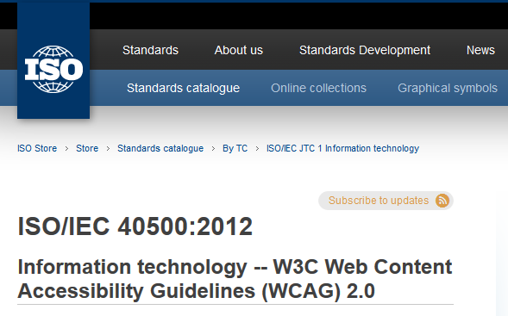
Web Content Accessibility Guidelines (WCAG) 2.0
WCAG 2.0 is the standard required by Australian law
  WCAG 2.0 is a framework of web accessibility guidelines developed by a working group of World Wide Web Consortium (W3C) to assist developers in creating websites that are accessible for all users, not just the able-bodied.
  Following these guidelines will make content accessible to a wider range of people with disabilities, including blindness and low vision, deafness and hearing loss, learning disabilities, cognitive limitations, limited movement, speech disabilities, photosensitivity and combinations of these.
International Organisation for Standardisation (ISO)
  WCAG 2.0 is an ISO/IEC International Standard (ISO/IEC 40500:2012).
Notes:
WCAG 2.0 is the accepted Australian and International Standard and is also now ISO 40500
Organisations may not be familiar with W3C and WCAG, but they certainly understand ISO
Most of you provide development work for organisations who are prepared to pay to ensure they are ISO compliant in numerous areas – business planning, financial, occupational health and safety,
but they may not be aware that there is an ISO standard for accessibility

Slide 8
What is covered by the requirements?
Internet
Intranet
Extranets
Documents that are downloaded from any of these sources
Notes:
What is covered by the requirements?
Internet
Intranet
Extranets (to your service providers and stakeholders)
All documents that you can download from a website or attachment
In short, anything you need to have an internet connection to access – even email

Slide 9
Who needs to be accessibility compliant
Anyone who has a website must be compliant under the World Wide Web Access: Disability Discrimination Act which is administered by the Australian Human Rights Commission
  This includes:
    Australian Government Agencies. Australian Government Agencies are also required to be compliant under the Web Accessibility National Transition Strategy.
    State and Territories. States and Territory Governments also have their own compliance requirements within the Australian Government framework
    Businesses
    Charities
    Educational organisations
    Individuals
Notes:
Who needs to be compliant?
Everyone from Joe’s Garage to the Prime Minister
Have you ever used a really unfriendly website and tried to find specific content – imagine using a difficult website if you can’t see or use your hands
It only takes one unhappy customer to complain to AHRC
It also only takes one bad experience for a customer to switch to a more accessible website if they can’t use yours and to tell their friends

Slide 10

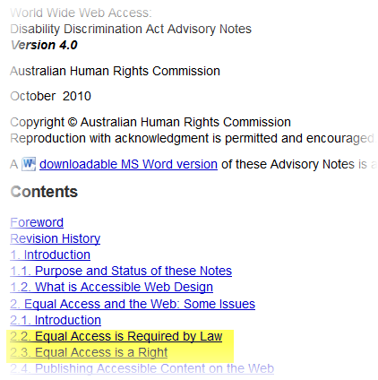
Australian Human Rights Commission
  Web content for both government and non-government organisations is covered by the Australian Human Rights Commission, Advisory Notes 4.0. which stipulates WCAG 2.0 Level AA by December 2013.
  The provision of information and online services through the web is a service covered by the Disability Discrimination Act (DDA).
  Equal access for people with a disability in this area is required by the DDA where it can reasonably be provided.
  This requirement applies to any individual or organisation developing a website or other web resource in Australia, or placing or maintaining a web resource on an Australian server.
  Web users with a disability who cannot access a website can, and do, take their cases to the Human Rights Commission.
Information source: Source: Australian Human Rights Commission
Notes:
These are the Guidelines for both government and non-government
Note: it says “This requirement applies to any individual or organisation”
Many people assume this is only for government
This isn’t ‘new news’ – it has been in the works since July 1, 2010
The AHRC administer the Disability Discrimination Act, and this is the litigation that applies to accessibility

Slide 11
The Australian Human Rights Commission…
Administers the Disability Discrimination Act 1991
In considering a disability discrimination complaint about web accessibility, the Commission takes into consideration the extent to which the best available advice on accessibility has been obtained and followed.
  There are a number of evaluation tools and techniques that web designers can employ to test the accessibility of their sites.
  AHRC and the Australian Government reaffirm the need for manual compliance testing of digital content as well as usability testing by people with disabilities and seniors
Source: World Wide Web Access: Disability Discrimination Act Advisory Notes ver 4.0 (2010), Section 3.2 The Importance of Expert Advice
Notes:
AHRC advises that you need to get expert advice
We advise organisations to consider getting a baseline accessibility evaluation to check their website’s compliance level, and make plans for gradual improvement
Don’t forget about testing with people with disabilities and also with seniors

Slide 12
Policy trends
Funding agencies are becoming more knowledgeable about the requirements
State and Local Government must produce a Disability Access & Inclusion Plan which is renewed regularly and asks what they are doing about access to information
Those in the know are now requiring contractors to provide evidence of accessibility knowledge and success – e.g. “show us a website you developed that meets WCAG 2.0 AA”
As many developers are not able to do this, now is the time to improve your marketability
Notes:
Policy is changing and people with disabilities are becoming more aware of their rights
This is your opportunity to stand out from the crowd.
The trend is now to embed accessibility requirements in an organisation’s DAIP and set targets to meet these requirements
This is where developers enter the arena – you will be asked to develop new digital materials to meet the accessibility requirements.
Can you do it? Do you know what the requirements are?

Slide 13
Government tendering requirements
In August 2016, the Australian Government adopted the Australian Standard for Procurement of ICT Products and Services
Originally the European Standard (EN 301549) and it is now known as (AS 301549)
Applies to all Australian Government procurement of ICT Products and Services – you can’t sell to the Australian Government without compliance (legal) with this standard
Anyone else can use it – and ask for a statement of compliance
A legally binding commitment from you to the funding agency that you will abide with the requirements
Incorporates WCAG 2.0 to Level AA as the accessibility standard
Notes:
Government tendering requirements
AS 301549 – have you heard about it?
Taken from EN 301549
ICT Products and Services
Requires a statement of compliance and will be legally enforceable
Anyone can use it
You need to get reading up on this – you will be required to provide a statement of compliance if any organisation puts this in their tendering documents. For Federal Government work – this is mandated – they have to require the document.
Next section – we will look at the Benefits and Repercussions related to digital accessibility

Slide 14


It’s time to change our thinking
Notes:
Section 3 – Benefits and Repercussions – slides 15-21
It’s time to change our thinking, but it won’t happen quickly
On the 2011 Census (not the recent), 20% of the population registered as having a disability that affects their education, employment or mobility
What about those with multiple less-disabling situations such as diminished eyesight, situations they don’t label as disabilities because of social stigma such as ‘dyslexia’, or ‘epilepsy’?
What about people who aren’t used to using computers, the seniors, people with English as a second language, or a combination of these? Its closer to 50%! That’s a lot of business to lose!

Slide 15
The power of the web is to be inclusive
Tim Berners-Lee, the inventor of the World Wide Web and Director of the W3C, has commented that:
"The power of the Web is in its universality. Access by everyone regardless of disability is an essential aspect."
Notes:
“The power of the Web is in its universality. Access by everyone regardless of disability is an essential aspect”
This is a very famous and much-used quotation.
However, please note both who said it, and that it brings our focus to one of the most important aspects of the Web – access by everyone is critical

Slide 16
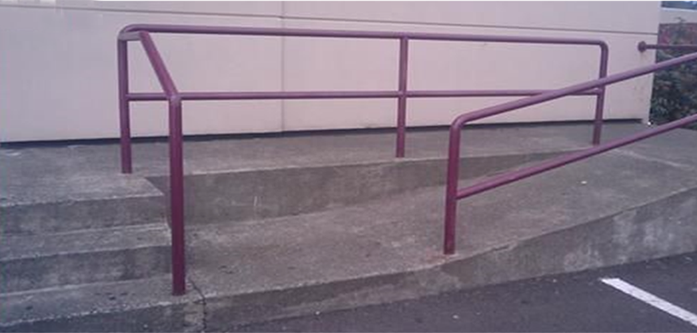
But! Are good intentions good enough?
Notes:
In the physical sense, we can see how ridiculous this wheelchair ramp design is.
Check your assumptions.
People in electric wheelchairs are usually independent and there is nothing saying anyone in a wheelchair has someone pushing them.
Have you ever seen wheelchair basketball players? Do you think any of those guys want someone pushing their chair?
So, are our assumptions for digital accessibility based on laziness, ignorance, or what?

Slide 17
Who does accessibility benefit in the community?
Everyone, but especially
People with disabilities
  1 in 5 users has a disability which is likely to increase to 1 in 4 within the next 10 years
Older users
  In most areas, over 12% of users are over the age of 60 (based on 2011 census data)
People with mobile devices
  Over 30% of users access a website via mobile phone or tablets and increasing
People living in areas with lower bandwidth
People with different cultural and linguistic backgrounds –
  In some areas, over 15% of users come from countries where English was not their first language.
Notes:
Everyone benefits from a more accessible website
Besides people with disabilities – see list in slide
approximately 12.5% of rate payers are over the age of 60 (based on 2011 census data)
Also according to census data, 18% of residents come from countries where English is not their first language
Did you know, that if you use the abbreviations “ph no” for phone number, that screen readers read this as “phuh-no”? Would someone with ESL understand what you mean?

Slide 18
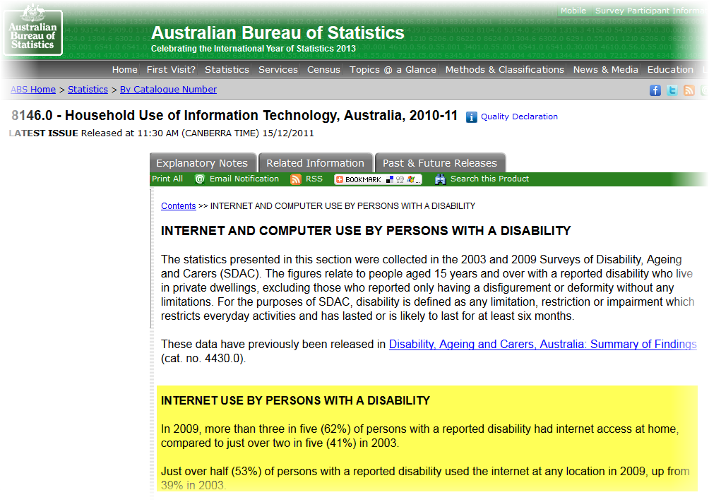
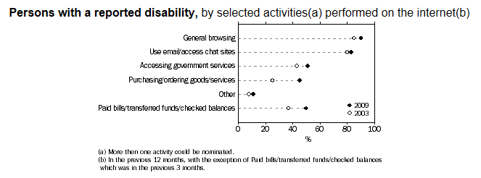
How does business benefit from accessibility?
Business Benefits
  Statistics show that:
    1 in every 5 Australians has a disability
    In 2009, more than three in five persons with a disability (62%) had internet access at home.
    Access to the internet by people with a disability is rising: 41% in 2003 to 62% in 2009.
  Make yourself known as an inclusive and non-discriminatory organisation and you will improve the user experience and encourage customers to return to your site.
Information source: Australian Bureau of Statistics, 8146.0 - Household Use of Information Technology, Australia, 2010-11, Internet and computer use by persons with a disability
Notes:
How does Business benefit?
You can boost your user base by up to 20% - the work you do to make the website accessible should pay for itself
More people will use your website
Existing users will be more loyal
It is great PR – shows that you’re committed to including as many users as possible – shows you’re ‘public-spirited’

Slide 19
Accessibility and search engines
It’s not just about people
Google is blind, deaf and cannot use a mouse.
Content that is accessible improves Search Engine Optimisation as well.
Website owners love SEO!
Notes:
How many times have the people who employ you asked you to make sure they are coming up on the first page of a Google search?
Incorporating accessibility makes a real difference in your SEO – think of heading structure, keywords, search feature, sitemap
you can also embed information in your website’s metadata stating it complies with WCAG if you want to improve it further still

Slide 20
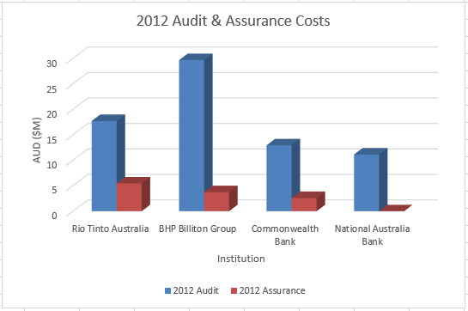
The Business Case for Accessibility
  Financial Audit and Assurance services in Australia are big business, and large enterprises are willing to pay millions of dollars to comply with legislation.
  Website Accessibility is no different – the standards are clear and legislated.
  While Australian discrimination payouts may be less than similar cases in the US, court costs escalate very quickly, as do urgent developer fixes that may be required in the event of an adverse finding.
Notes:
Organisations in Australia spend millions of dollars on financial compliance, but seldom spend anything on website accessibility compliance
Organisations don’t hesitate to spend money making sure their physical premises are accessible
We often state that website accessibility is the digital equivalent of the wheelchair ramp
Organisations are having to face AHRC mediation regularly and this is expensive– while cases are usually settled out of court, there is usually still legal costs plus you still have the cost of fixing your website – it isn’t either or
It is less expensive to design for ‘maximum accessibility’ at the start
When is your website going to be re-vamped? The average is every 2 years.
Why not check out the existing problems and then build these fixes into the next iteration of the website?

Slide 21
Other benefits to the website owner and you as the developer
Positive public relations
Improved user satisfaction – good PR for the website owner and developer as well
Reduced cost of time answering queries for client – they will love the cost-saving
Reduced risk of litigation – you and your client
Learning a whole new skillset and become sought after for your development ability – makes you more employable
Notes:
Are you understanding yet that there are lots of benefits in designing inclusively?
The benefits are both to you and to the website owner
You’ll also be making yourself much more marketable

Slide 22
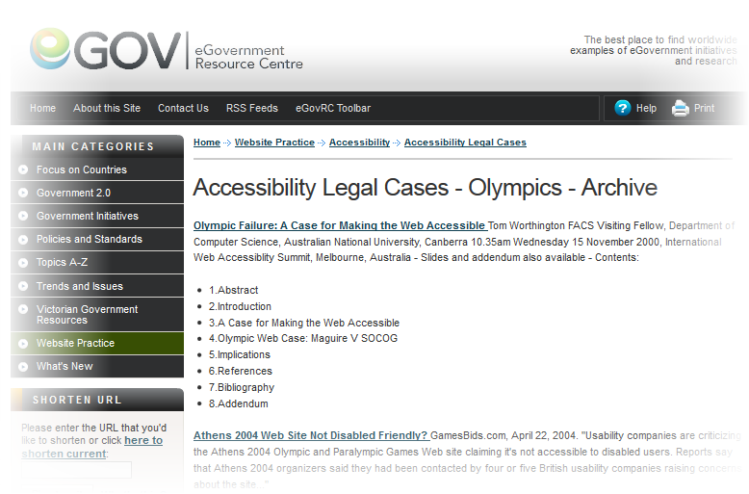
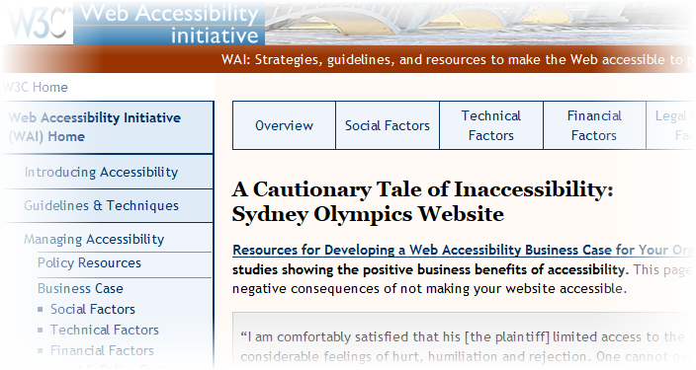
What happens if I do nothing?
If your website is inaccessible:
    You could be losing up to 20% of your traffic, notwithstanding the effectiveness of your online marketing strategies.
    You may be opening yourself up to the risk of litigation. Organisations already affected include: Coles, the Canadian Government, Target (USA), Travel sites Ramada and Priceline, Sydney Olympics and more recently Coles.
    You may lose the trust and respect of your clients.
    Other organisations who are better prepared will attract your traffic.
Information sources:
eGovernment Resource Centre: Accessibility Legal Cases - Olympics - Archive;
W3C Web Accessibility Initiative - A Cautionary Tale of Inaccessibility: Sydney Olympics Website
Notes:
What happens if I do nothing? Understand the risks
loss of website traffic
Risk of litigation
Loss of respect of clients
Users moving to a company with a more accessible website – think of banking.
Everyone needs a bank account so people with disabilities would bank with the provider with the most accessible website
Next Section – we will look at some examples

Slide 23

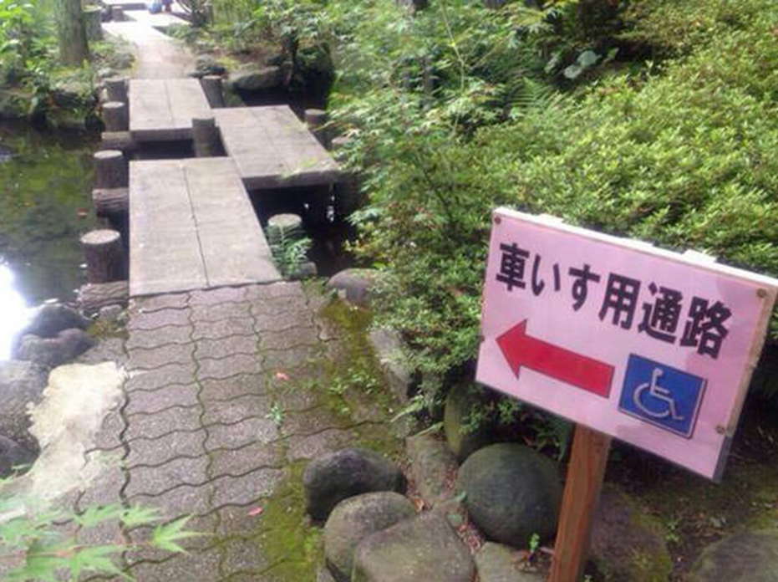
Build access not barriers
Notes:
Section 4 – Examples – slides 22-36
Wheelchair access? Are you kidding me?
Can you hear the Vegas-style slot machine ringing bells as the insurance company lawyers head to court to slog it out with the property owner’s lawyers?
This isn’t just risky, it’s deadly, unless of course you are into wheelchair extreme sports

Slide 24
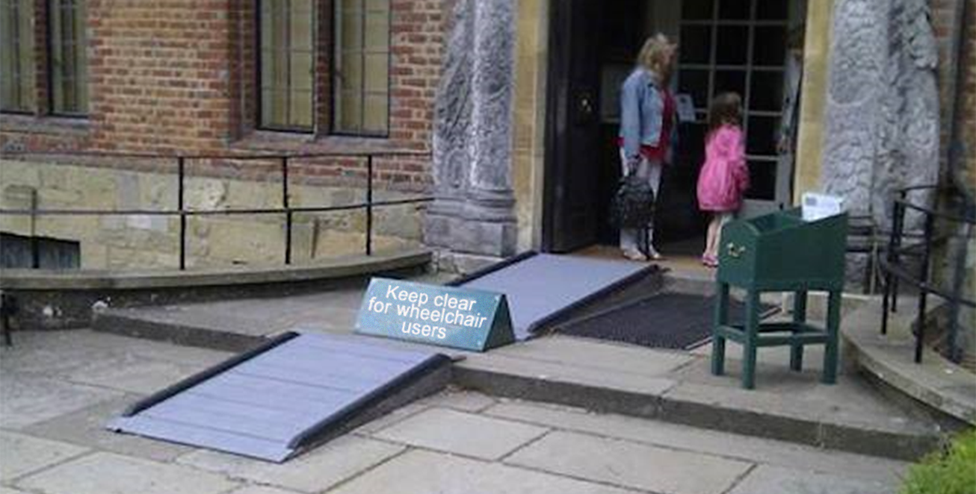
Putting blockers in the way
Notes:
Really?
And its not just the steps and ridiculously steep slopes of ramps.
The crazy thing here is that the sign is blocking the ramp access.
What on earth were they thinking?
I approach the building having been told it was accessible, and right in the middle of the ramp is a sign that I can’t get around!
Let’s move the sign to the side, or just print the message right onto the ramp. How difficult is that? It’s not that the sign is a work of art!

Slide 25

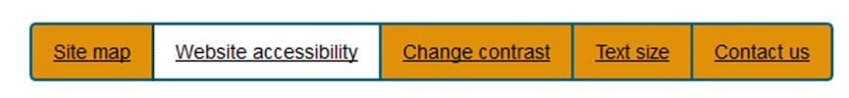
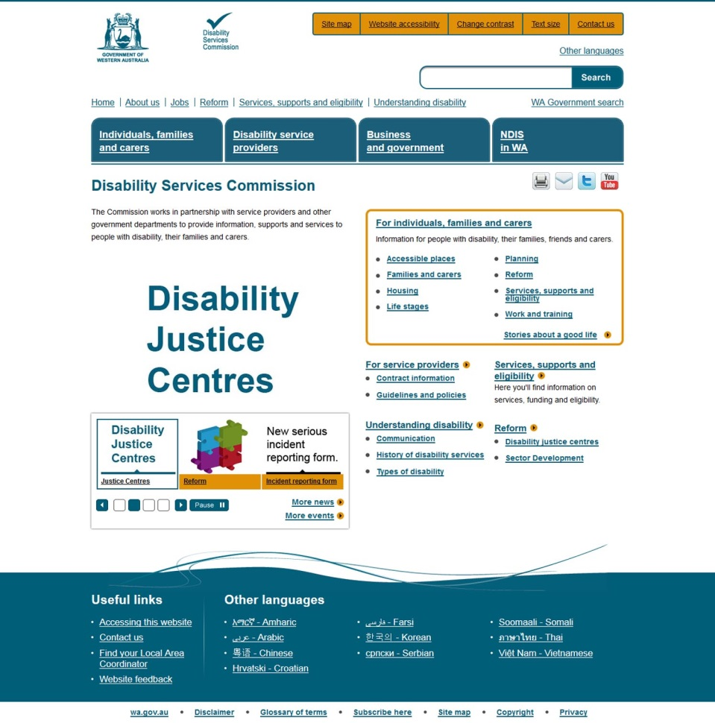
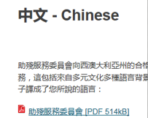
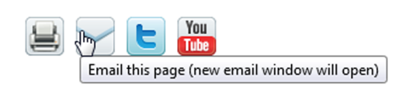

Accessibility: Small differences, big benefits
2
1
3
Skip links
Clear focus
Language support
Event warnings
Sufficient contrast
Control over media
4
5
6
Notes:
This is just an example from some work we’ve done with the Disability Services Commission.
They’ve been working really hard to set an example for other government departments to follow
6 points for a good design – skip links, clear focus, language support, event warnings, sufficient colour contrast, control over media

Slide 26
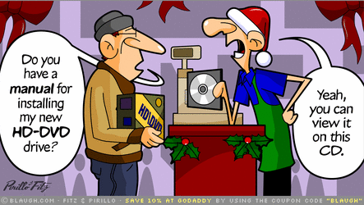
Know your customer’s needs
Notes:
Can everyone use what you create?
In the Coles case, it was all about the user journey!
What good is being able to select products if you can’t get them ordered and delivered?
Explain the Coles process – result – court and legal costs, loss of customers, loss of PR, still had to fix the website and promise to maintain its accessibility
The complainant said that it makes people with disabilities feel like they don’t matter, and wondered if they would treat all customers that way.
In the Coles case, the fix was not extensive, and going to court was a last resort for the user
But it was a costly mistake by Coles to refuse to fix it – think of the publicity, loss of sympathetic customers etc.

Slide 27
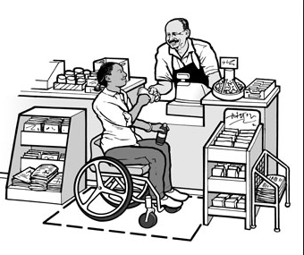
Looking at accessibility issues and the associated WCAG 2.0 Guidelines
Notes:
How much effort will you put into designing for accessibility?
Do you see now that it is worth the effort?
What are some of things we can do to make it easier for people to use our websites?
What about keyboard accessibility, screen-reader accessibility, sufficient colour contrast for those who are colour-blind, not having flickering content which might provoke seizures, making sure content doesn’t move without controls to stop the movement
It’s good to know that doing these things is already considered ‘best practice’.
So do you as developers, understand accessibility? Do you even know what is required? What is your responsibility?
The following slides show some of the more common issues we see when looking at the accessibility of websites.

Slide 28
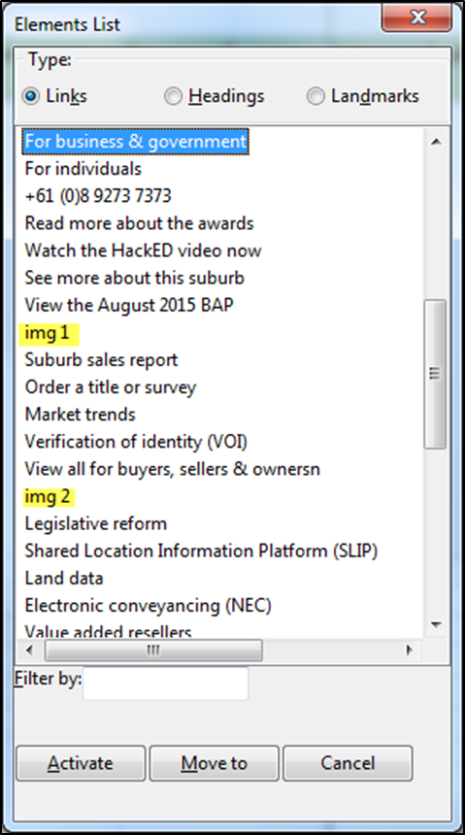
Links need to make sense out of context
WCAG 2.0
2.4.4 Link Purpose (In Context):
The purpose of each link can be determined from the link text alone or from the link text together with its programmatically determined link context, except where the purpose of the link would be ambiguous to users in general. (Level A)
2.4.9 Link Purpose (Link Only):
A mechanism is available to allow the purpose of each link to be identified from link text alone, except where the purpose of the link would be ambiguous to users in general. (Level AAA)
Notes:
Links need to make sense in and out of context
Screen reader users can ask for a list of links so that they don’t have to navigate through familiar pages – just find the link they want
If the link text doesn’t make sense, users won’t use it – defeats the purpose of the link
Make it easy for the user to find what they need – it is just good business sense
Would you expect people to find products in a store if you hid them?

Slide 29
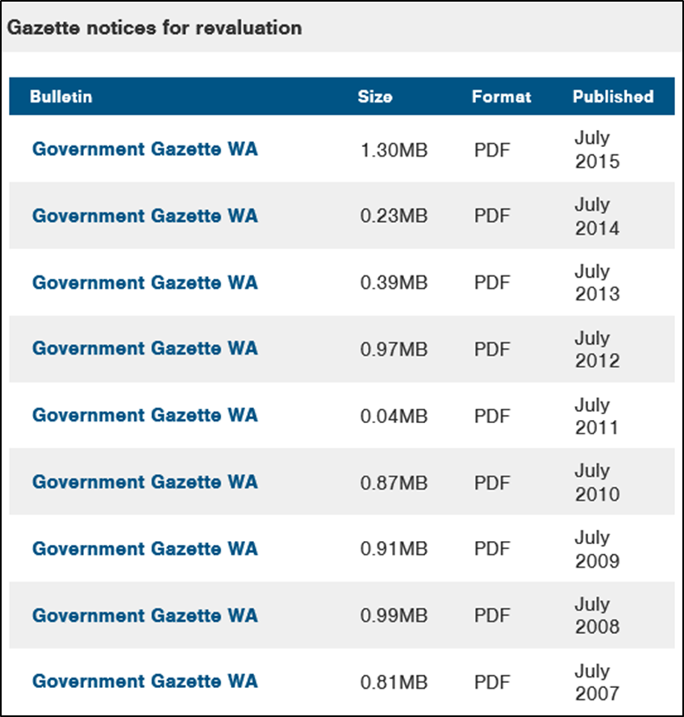
Using links with the same name
Notes:
How would you know which link you wanted? – they would all sound the same, so the user wouldn’t action any of them.
Imagine wanting the gazette for July 2008, you’d have to listen to the whole table

Slide 30
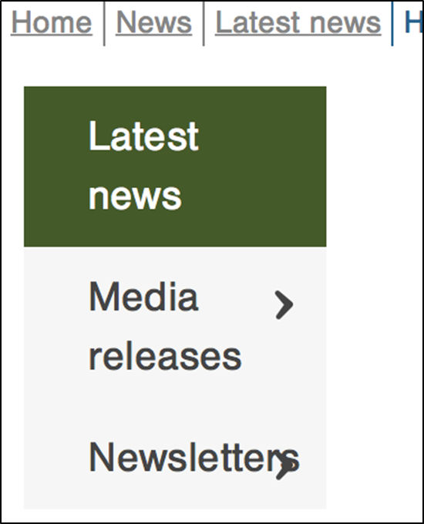
People need to enlarge text
WCAG 2.0
1.4.4 Resize text:
Except for captions and images of text, text can be resized without assistive technology up to 200 percent without loss of content or functionality. (Level AA)
Notes:
People with low vision need to enlarge text
The problem here is that when the text is enlarged, the carets don’t adjust position – there is probably a fixed size used for the content area
The WCAG rule is that you need to be able to enlarge text to 200% without loss of functionality or visibility
The WCAG 2.1 rule coming is 400%
The fact is that if you have low vision you may need to enlarge text to 400 or 500%, so using fixed sizes limits the ability to view the content

Slide 31
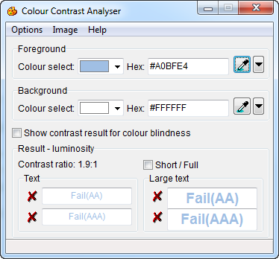
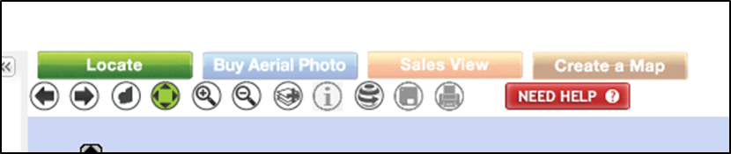

Colour Contrast Issues
WCAG 2.0
1.4.3 Contrast (Minimum): The visual presentation of text and images of text has a contrast ratio of at least 4.5:1, except for the following: (Level AA)
Large Text: Large-scale text and images of large-scale text have a contrast ratio of at least 3:1;
Incidental: Text or images of text that are part of an inactive user interface component, that are pure decoration, that are not visible to anyone, or that are part of a picture that contains significant other visual content, have no contrast requirement.
Logotypes: Text that is part of a logo or brand name has no minimum contrast requirement.
Notes:
Colour Contrast Issues
Do you see the problem here with the colours for the buttons?
You don’t even need to use a colour contrast analyser to see the problem with these colours and the gradient
Even with good eyesight, it is hard to read these
The rule is a contrast of foreground to background of 4.5:1 for regular sized text and 3:1 for large text (think H1 level)

Slide 32
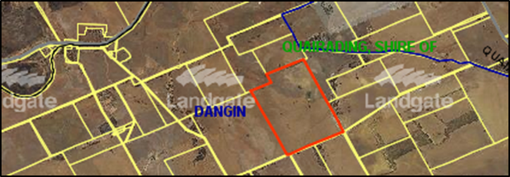
More colour issues
How would this work if you were colour blind or had low vision?
Notes:
One in 10 men are colour blind and wouldn’t be able to use this information
What about someone who is blind? Be careful of your assumptions. Don’t assume that people with disabilities don’t purchase products, property, trips, need employment resources and the list goes on
In this case, you would need to provide this information in a text-based form

Slide 33

How would I know what these symbols mean?
WCAG 2.0
1.1.1 Non-text Content:
All non-text content that is presented to the user has a text alternative that serves the equivalent purpose, except for the situations listed below. (Level A)
Controls, Input: If non-text content is a control or accepts user input, then it has a name that describes its purpose.
Notes:
Would the person listening with a screen reader know what these symbols meant?
If the screen reader can’t receive the information via alternative text that should be provided, it would read ‘image’ and either nothing following, or the URL where the image came from.
Sometimes the URL’s are really long and the user will just leave the website

Slide 34
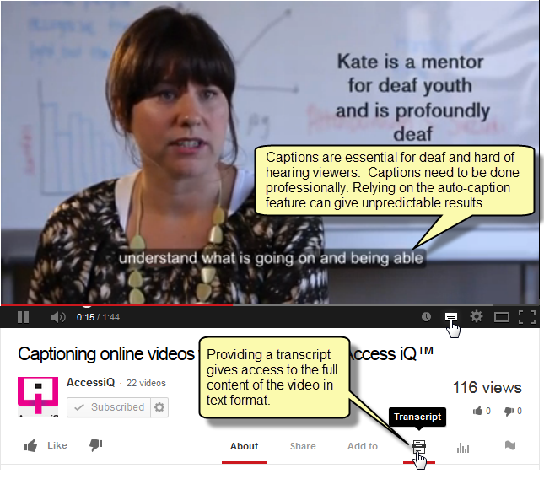
‘Out of Site’ Benefits - YouTube
WCAG 2.0
1.2.2 Captions (Prerecorded):
Captions are provided for all prerecorded audio content in synchronized media, except when the media is a media alternative for text and is clearly labeled as such. (Level A)
1.2.3 Audio Description or Media Alternative (Prerecorded): An alternative for time-based media or audio description of the prerecorded video content is provided for synchronized media, except when the media is a media alternative for text and is clearly labeled as such. (Level A)
Notes:
Pre-recorded videos need captions and transcripts.
You probably already have most of this information – it was needed to create the video in the first place
You could use the YouTube automatic captioning – but please remember to edit it to remove the rubbish. But at least the timing is there for you.
Use voice-activation software or just record the message for the video and use that to create a transcript

Slide 35
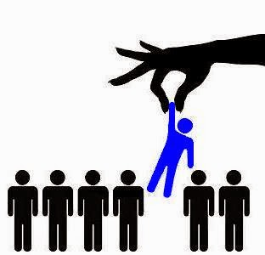
Be an accessible developer
We need you!
Stand out from the crowd
Get chosen
Notes:
Be an accessible developer and make a difference!
Get selected for assignments because of your ability to create inclusive websites
It’s time to stand out from the crowd

Slide 36
Picking a good developer – our advice to clients
Evidence
  We sat on a tender finalists’ panel to help a local government pick their developer for a website
  Each developer was asked to produce evidence of websites they had developed that were compliant
  Result – none were – not even close!
  Looked at the developer’s own website – even worse!
First check the supplier’s own website – is it compliant?
  This is how you advertise – people will look to see if you have an understanding of accessibility requirements
Check the work they have done for other clients? Has it been compliant?
Will the developer accept external audit of work under construction? If not, why not?
Notes:
We are often asked by our customers to help them find a developer who understands accessibility
Our advice to you is to have evidence of your ability to design inclusively - be ready to show prospective clients
Better yet, have that evidence tested so you’re sure of the rating
Fix your own website – it is your advertising of your abilities
While it might be understandable in some form – like the mechanic having the worst car on the block, this is where customers view your capabilities
If your website is inaccessible, there is no reason for the customer to think that what you’d would create for them would be accessible
Be willing to work with external accessibility consultants – welcome the learning you’ll receive
Accessibility Consultants would love to be able to name you when asked for recommendations – accessible developers are few and far between

Slide 37
Common developer pitfalls
Misplaced belief in their own ability
  Checked nominations for national awards and matched their stated compliance claims with a manual audit
  Results showed none of them met the compliance claimed – why?
  Answer – they either didn’t know how to evaluate accessibility, or they thought that they were the best so it should be compliant, or they didn’t tell the truth
Reliance on robotic tools to measure compliance
  Automated testing tools will only pick up 18-35% of accessibility issues
  Federal Government clearly state not to rely on automated tools
Use of non-compliant third party widgets and apps
  You are responsible for what you use on the website – if it isn’t accessible, then neither is the website
    E.g. Winn-Dixie case in the US
    Don’t use it, customise it, pressure the vendor, or find another source!
    It’s not worth the risk! Can cause the best website to fail and leave you at risk
Notes:
Common Pitfalls
Don’t say that you can do something that you can’t
If you’re still learning, say so – tell clients you will work to make sure that you meet the requirements and to do whatever it takes
Please don’t fall into the trap of relying on automated tools
Watch out for third-party content and don’t use that as a ‘get out of jail free’ card.

Slide 38
Challenges to implementing accessibility
Difficult issue of third-party content such as databases
Video recording - captioning and transcripts
Knowledge of guidelines and what level to meet
How do I know if what I create is accessible?
Notes:
There are some challenges ahead for you
Such as third party content
Multi-media
Knowing the guidelines
And knowing how to evaluate the accessibility of your work

Slide 39

Designing for Universal Access
Notes:
Design so that everyone possible can use the great digital product you’ve created – design for Universal Access
Think about your client’s user journeys
Create personas and imagine how people would use your products and services
Consult experts, seniors and people with varying capabilities
Don’t be afraid to learn new things
Remember that you’re aging also – design for your future and that of those you love
Design as though it matters!
Next section – We will look at what we have learned so far…

Slide 40

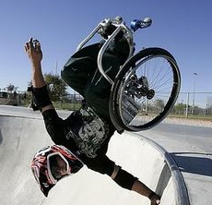
Accept the challenge!
Notes:
Section 5 – Conclusion – what have we learned?
I expect you have learned that I’d like you to accept the challenge and face your fears
Most of the changes you need to embrace are considered ‘best practice’, so in effect you will be ahead of the pack
Designing for accessibility is more cost-efficient than trying to retrofit an existing website
Remember that for most businesses, there is only about a 2 year cycle before you start to need to make changes or to refresh/remake a website
Design the next website and prepare to help your customer benefit from the
additional customers
enhanced customer experience
positive public relations, and
reduced risk of litigation
Think ‘inclusive’
Learning new skills is stressful, but what if it made you more sought-after for development work?

Slide 41


Let’s unlock the web
Notes:
It’s not about disability, it’s about accessibility!
Remember, people don’t have disabilities.
People all have different capabilities and we disable them by putting obstacles in their paths!
Instead of putting up those obstacles, let’s start removing them!
Bit by bit, can we make a change in the lives of people
Accessibility matters! Let’s unlock the Web!

Slide 42

Thank you – do you have any questions?
You can get further information on our services at our website,
Web Key IT at www.webkeyit.com
You can email me:
v.conway@webkeyit.com
Vivienne Conway, Director
Notes:
Please feel free to talk with me
Advice is always free!

Slide 43
Reference: Sources of information
W3C: Understanding WCAG 2.0
ISO/IEC 40500:2012. Information technology -- W3C Web Content Accessibility Guidelines (WCAG) 2.0
Australian Government. Web Guide: Accessibility
Web Accessibility National Transition Strategy
Australian Human Rights Commission. World Wide Web Access: Disability Discrimination Act Advisory Notes ver 4.0 (2010)
eGovernment Resource Centre: Accessibility Legal Cases - Olympics - Archive;
W3C Web Accessibility Initiative - A Cautionary Tale of Inaccessibility: Sydney Olympics Website
Australian Bureau of Statistics, 8146.0 - Household Use of Information Technology, Australia, 2010-11, Internet and computer use by persons with a disability
Website Accessibility Conformance Evaluation Methodology (WCAG-EM) 1.0
Digital Service Standard

